Slide 1
Business Statistics
MBA104
Unit 1
Introduction to Statistics: Meaning and Definition, functions, scope and limitations, Collection and presentation of data, frequency distribution, measures of central tendency - Mean, Median, Mode, Geometric mean, Harmonic mean,
Measures of dispersion: Range – Quartile Deviation – Mean Deviation - Standard Deviation – Variance- Coefficient of Variance - Comparison of various measures of Dispersion, Moments and Kurtosis
Unit 2
Correlation and Regression: Scatter Diagram, Karl Pearson correlation, Spearman’s Rank correlation(one
way table only), simple and multiple regression(problems on simple regression only)

Slide 2
Unit 3
Probability Distribution: Concept and definition - Rules of probability – Random variables – Concept of probability distribution – Theoretical probability distributions: Binomial, Poisson, Normal and Exponential –
Baye’s theorem (No derivation) (Problems only on Binomial, Poisson and Normal).

Slide 3
Unit 4
Time Series Analysis: Introduction - Objectives Of Studying Time Series Analysis - Variations In Time Series
- Methods Of Estimating Trend: Freehand Method - Moving Average Method - Semi-Average Method - Least
Square Method. Methods of Estimating Seasonal Index: Method Of Simple Averages - Ratio To Trend Method
- Ratio To Moving Average Method

Slide 4
Unit 5
Hypothesis - types, characteristics, source, formulation of hypotheses, errors in hypotheses. Parametric and Non-Parametric Tests- t-test, z-test, f-test, u-test, K-W Test (problems on all tests) Statistical analysis- Bivariate and Multivariate Analysis- ANOVA-one-way and two-way classification (theory only).

Slide 5
Unit 6
Computer lab for Statistics: SPSS: Overview of SPSS , Creating, saving and editing files, Importing files from other formats. Transforming Variables - Compute, Multiple responses. Organization and Presentation of
Information - Measures of Central Tendency and Variability, Frequency Distributions. Charts and Graphs, Hypotheses testing using means and cross-tabulation , Paired t, Independent sample t, Chi- square.
Correlation, Regression Analysis , Linear, Logistic, Analysis of Variance- One Way ANOVA, ANOVA in regression.

Slide 6
Module 1
STATISTICS
Introduction to Statistics: Meaning and Definition, Importance, Types, Measures of Central Tendency - Arithmetic mean, Geometric mean, Harmonic mean, Median, Quartiles, Deciles, Percentiles, Mode.
Measures of Dispersion -Range, Quartile deviation, Mean deviation, Standard deviation, Variance, Coefficient of Variation. (Theory and Problem).

Slide 7
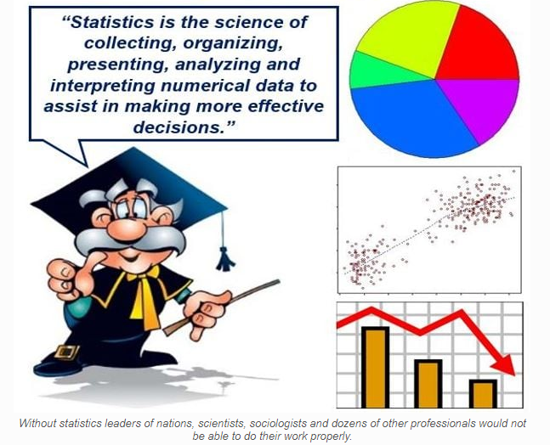

Slide 8
WHAT IS STATISTICS ?
As a discipline it is concerned with the collection, analysis, and interpretation of data, as well as the effective communication and presentation of results relying on data.

Slide 9
The word ‘ Statistics’ and ‘ Statistical’ are all derived from the Latin word Status.
Statistics is concerned with scientific methods for
collecting,
Organising = arrange systematically in order,
Summarising = put in a nutshell,
presenting and
analysing data = to study or examine something in detail, in order to discover more about it
as well as deriving valid conclusions and making reasonable decisions on the basis of this analysis.

Slide 10
Modern companies have increasing amounts of internal data in their databases and data warehouses, like accounting data, financial data, sales data, quality performance data, employee productivity data, and so on.
These kinds of data are produced as a result of daily operations.
Data may also be purposely generated like when doing a marketing research.
External data are available from governmental, industrial, or individual sources.

Slide 11
DATA SUPPORTING DECISION MAKING
Business managers and decision makers have access to large amounts of information.
A major issue is how to use available information in order to make better decisions.
Quantitative data are an essential part of any business and they help to make better decisions.
quantitative data helps to explain and justify decisions.

Slide 12
SUMMARIZING AND ANALYZING DATA
Data have to be collected and converted into understandable and interpretable information.
A decision maker should be able to read, interpret and understand information correctly.
Converting data into useful information can be done by using charts, tables and descriptive statistics (like mean, median, standard deviation).
Raw data = Just a collection of numbers.
Information = Data presented in a way one can understand, interpret and use.

Slide 14
WHY STUDY STATISTICS ?
Knowledge in statistics provides you with the necessary tools and conceptual foundations in quantitative reasoning to extract information intelligently from this sea of data.

Slide 15
STATISTICAL METHODS
Methods adopted in the collection and analysis of numerical information or statistical data for the purpose of drawing conclusions and making decisions are called Statistical Methods.
Types of Statistical Methods:
Statistical methods fall into two categories:
Descriptive Statistics
Inferential Statistics

Slide 16
DESCRIPTIVE STATISTICS (seeking to describe) includes statistical methods involving the collection, presentation, and characterization of a set of data in order to describe the various features of that set of data.
With descriptive statistics you are simply describing what the data shows
In general, methods of descriptive statistics include graphic methods such as Histogram, Frequency Polygon/Curve, Cumulative frequency polygon/Curve, Bar charts, line graphs, pie charts etc,
Descriptive statistics is the term given to the analysis of data that helps describe, show or summarize data in a meaningful way such that, for example, patterns might emerge from the data.

Slide 17
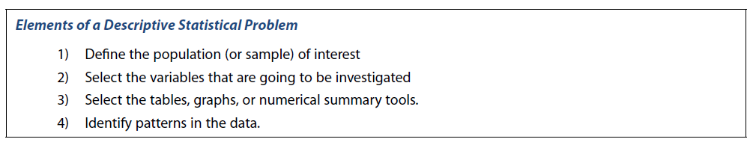
For example, if we had the results of 100 pieces of students' coursework, we may be interested in the overall performance of those students. We would also be interested in the distribution or spread of the marks. Descriptive statistics allow us to do this.

Slide 18
INFERENTIAL STATISTICS
deals with procedures for making inferences about the characteristics, from only a part of the data, known as Sample which describes the larger group of data, called population,

Slide 19
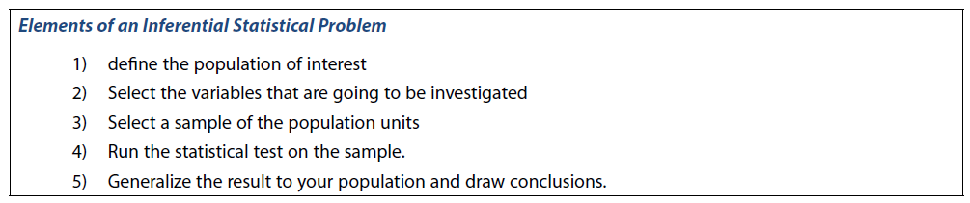

Slide 20
POPULATIONS AND SAMPLES
A population or a statistical population is a collection or set of all possible observations whether from a finite or infinite population, relevant to some characteristics of interest.
In finite universe the number of items is certain, Ex. The population of a city,
The number of observations in a finite population is called the size of the population (N).
In case of an infinite universe the number of items is infinite, i.e., we cannot have any idea about the total number of items. Example the number of stars in the sky, listeners of a specific radio programme, etc. are examples of infinite universes.
A sample is a part or a subset of population. The number of observations included in a sample is called the size of the sample (n).
The information derived from sample is used to draw conclusions about the population.

Slide 21
OBSERVATIONS, DATA
In statistics, an observation often means any sort of numerically recording of information, whether it is a physical measurement such as height, or weight; or a classification such as eye color, answer to a question such as yes or no.
A collection of such observations may be termed as data or Statistical data.
Data may be classified into two types, viz. Qualitative data and Quantitative data.
Qualitative data. When the population is divided into several categories, it is possible to count the number of individuals in each category. These counts are the Qualitative data. For example, eye color, blood type, gender etc.
Quantitative data. Observations, which are measured quantitatively (numerical measurement) give rise to Quantitative data. such as height, or weight, temperature, time, cholesterol level, blood pressure, etc.

Slide 22
VARIABLES
A characteristic that varies with an individual or an object, is called a variable.
For example, age is a variable as it varies from person to person. Variables may be classified into Quantitative and Qualitative.
A variable is called qualitative variable if the characteristic is non-numerical such as education, honesty, intelligence, poverty, satisfaction, etc.
A variable is called quantitative variable when a characteristic can be expressed numerically such as age, weight, height, income or number of children.

Slide 23
DISCRETE AND CONTINUOUS VARIABLES
A quantitative variable may be classified as discrete or continuous variable.
A DISCRETE VARIABLE is one that can only take certain fixed integer numerical values or whole numbers.
Discrete data are numerical measurements that arise from a process of counting, such as the number of children in a family, number of rooms in a house, number of road accidents, births, deaths etc.
CONTINUOUS VARIABLES — which can take any numerical value. examples Measurement of height, weight, length, in centimeters / inches, grams/kilograms are a of continuous variables.
continuous data are numerical measurements that arise from a process of measuring.

Slide 24
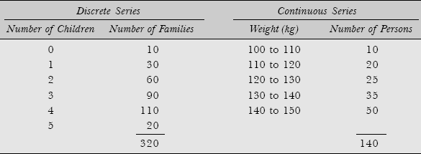

Slide 25
Role of Statistics in Business Management
Certain activities of a typical organization where Statistics plays an important role in their execution are discussed below
Marketing
Before a product is launched, the market research team of an organization, through a pilot survey, makes use of various techniques of statistics to analyze data on population, purchasing power, habits of the customers, competitors, pricing etc. such studies reveal the possible market potential for the product to be launched.
Production
Statistical methods are used to carry out R&D programs for the improvement in the quality of the existing products and setting quality control standards for new ones. Decisions about the quantity and time of either self-manufacturing or buying from out-side are based on statistically analyzed data

Slide 26
Finance
A statistical study through correlation analysis of profits and dividends helps to predict and decide probable dividends for future years. Statistics, applied to analysis of data, on assets and liabilities and income and expenditure helps to ascertain the financial results of various operations.
Financial forecasts, break-even analysis, investment decisions under uncertainty all involve the application of relevant statistical methods for analysis.
Personnel
In the process of manpower planning, a personnel department makes statistical studies of wage rates, incentive plans, cost of living, labor turnover rates, employment trends, accidents rates, performance appraisal and training and development programs. Employer-employee relationships are studied by statistically analyzing various factors such as wages, grievances handling, welfare, delegation of authority, education and housing facilities, and training and development.

Slide 27
MEANING OF MUTUALLY EXCLUSIVE AND COLLECTIVELY EXHAUSTIVE
The literal definition of “mutual” means “held in common,” and the literal definition of “exclusive is “restricted to.”
So, “mutually exclusive” means that each individual piece, part or object of a group of “something” (whatever that “something” is) should be considered individually, even though the collective group of events have commonalities or common elements.
Whereas “collectively” means the entire collection or group of “something” should be thought of together or as one item.
“Exhaustive” means “all elements of something such that nothing is left out, fully comprehensive, complete.”
So, “collectively exhaustive events” means the collection group of events is complete such that no event is left out or no other event can be added to the group of events.
EXAMPLE: The set of all possible die rolls is both mutually exclusive (DIE HAVING 6 FACES – 1….6 HELD IN COMMON but Restricted to (EXCLUSIVELY ONE OUT COME)) and
collectively ( DIE WHICH IS OF 6 FACES IS THOUGHT OF AN ONE ITEM - WHILE SPINNING EVERY FACE OR EVERY NUMBER HAS EQUAL CHANCE – NO FACE IS LEFT OUT ) exhaustive.

Slide 28
Statisticians are in demand in all sectors of society, ranging from government, to business and industry, to universities and research labs.
As a statistician you can be involved with the development of new lifesaving drugs in a pharmaceutical, the shaping of public policy in government, the planning of market strategy in business, or the management of investment portfolios in finance.
Not only are there a wide variety of exciting opportunities for statisticians, but careers in statistics generally can be quite lucrative, with statisticians of sufficient experience often able to earn six-figure salaries.

Slide 29
CLASSIFICATION OF DATA
Classification of data is the process of arranging data in groups/classes on the basis of certain properties. The classification of statistical data serves the following purpose:
It condenses the raw data into a form which is suitable for statistical analysis.
It facilitates comparisons and in drawing inferences from the data.
For example, if university students in a particular course are divided according to sex that is male or female, their results can be compared.

Slide 30
Basis of Classification
Generally, data are classified on the basis of the following four bases:
Geographical Classification In geographical classification, data are classified on the basis of geographical or locational differences such as—cities, districts, or villages between various elements of the data set. The following is an example of a geographical distribution
Chronological Classification When data are classified on the basis of time, the classification is known as chronological classification. Such classifications are also called time series because data are usually listed in chronological order starting with the earliest period. The following example would give an idea of chronological classification:

Slide 31

QUALITATIVE CLASSIFICATION
In qualitative classification, data are classified on the basis of descriptive characteristics or on the basis of attributes like sex, literacy, region, caste, or education, which cannot be quantified. This is done in two ways:
Simple classification: In this type of classification, each class is subdivided into two sub-classes and only one attribute is studied such as: male and female; blind and not blind, educated and uneducated, and so on.
Manifold classification: In this type of classification, a class is subdivided into more than two sub-classes which may be sub-divided further. An example of this form of classification is shown in the box:
Quantitative Classification In this classification, data are classified on the basis of some characteristics which can be measured such as height, weight, income, expenditure, production, or sales.

Slide 32
FREQUENCY
In statistics the FREQUENCY of an event is the number ‘n’ of times the event occurred in an experiment or study
In statistics, a frequency distribution is a table that displays the frequency of various outcomes in a sample.
A frequency distribution divides observations in the data set into conveniently established, numerically ordered classes (groups or categories).
The number of observations in each class is referred to as frequency denoted as f.

Slide 33
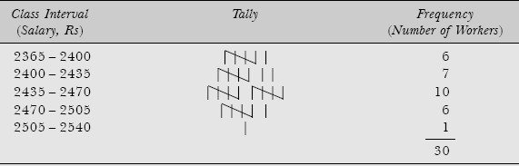
CLASS INTERVAL refers to the numerical width of any class in a particular distribution.
Mathematically it is defined as the difference between the upper class limit and the lower class limit
Class Interval = Upper Class limit – Lower class limit
In statistics, the data is arranged into different classes and the width of such class is called class interval. Class intervals are generally equal in width but this might not be the case always.

Slide 34

Fixing class interval
If k represents the number of classes and N the total number of observations, then the value of k will be the smallest exponent of the number 2, so that 2^{k} ≥ N.
If we have N = 30 observations. If we apply this rule, then we shall have
Thus we may choose k = 5 as the number of classes.

Slide 35

Example: The following set of numbers represents mutual fund prices reported at the end of a week for selected 40 nationally sold funds. Arrange these prices into a frequency distribution having a suitable number of classes.

Slide 36
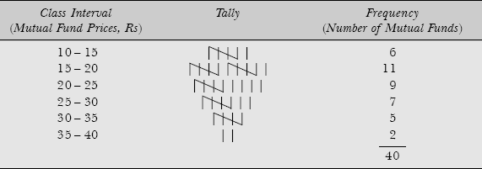
Solution: Since the number of observations are 40, it seems reasonable to choose 6 (2⁶ > 40) class intervals to summarize values in the data set. Again, since the smallest value is 10 and the largest is 38, therefore the class interval is given by

Slide 37
There are TWO WAYS IN WHICH OBSERVATIONS in the data set are classified on the basis of class intervals, namely
Exclusive method, and
Inclusive method
Exclusive Method When the data are classified in such a way that the upper limit of a class interval is the lower limit of the succeeding class interval then it is said to be the exclusive method of classifying data.
Dividend Declared in per cent Number of Companies | Number of Companies (Frequencies)
0–10 | 5
10–20 | 7
20–30 | 15
30–40 | 10

Slide 38
Inclusive Method When the data are classified in such a way that both lower and upper limits of a class interval are included in the interval itself.
To ensure continuity, first calculate correction factor:
From Table we have x = (44 – 45) ÷ 2 = 0.5.
Subtract 0.5 from the lower limits of all the classes and add 0.5 to the upper limits. is said to be the inclusive method of classifying data.
Class Interval | Frequency
30–44 | 28
45–59 | 32
60–74 | 45
75–89 | 50
90–104 | 35

Slide 39
Dividend Declared in per cent Number of Companies | Number of Companies (Frequencies)
29.5 – 44.5 | 28
44.5 – 59.5 | 32
59.5 – 74.5 | 45
74.5 – 89.5 | 50
89.5 – 104.5 | 35

Slide 40
CENTRAL TENDENCY
The term ‘central tendency’ was coined because observations (numerical values) in most data sets show a distinct tendency to group or cluster around a value somewhere in the middle of all observations.
Therefore, it is necessary to identify or calculate this typical central value (also called average) to describe or project the characteristic of the entire data set.
This descriptive value is the measure of the central tendency or location and methods of computing this central value are called measures of central tendency.

Slide 41
Notes about Central Tendency
The common assumption of statistical test is that data is normally distributed. For normally distributed data we can use any of the central tendency method (mean, mode or median), because for symmetrical data all the three values are equal.

Slide 42
MEASURES OF CENTRAL TENDENCY
The various measures of central tendency or averages commonly used can be broadly classified in the following categories:
Mathematical Averages
  Arithmetic Mean commonly called the mean or average
    Simple
    Weighted
  Geometric Mean
  Harmonic Mean
Averages of Position
  Median
  Quartiles
  Deciles
  Percentiles
  Mode

Slide 43
What is the difference between grouped and ungrouped data?
Grouped data is data that has been organized into classes. Grouped data has been classified and some data analysis has been done, which means this data is no longer raw.
Un-grouped data has not been organized into groups. It is just a list of numbers.

Slide 44
Notations
F_{i} = number of observations (or frequency) in the ith class; (i= 1, 2,…, N)
N = total number of observations in the population
n = number of observations in the sample (sample size)
h = width (or size) of the class-interval
Cf = cumulative frequency
Σ = summation (read: sigma) of all values of observations

Slide 45
ARITHMETIC MEAN
A calculated "central" value of a set of numbers.
To calculate: add up all the numbers, then divide by how many numbers there are.
Example: what is the average of 2, 7 and 9?
Add the numbers: 2 + 7 + 9 = 18
Divide by how many numbers (i.e. we added 3 numbers): 18 ÷ 3 = 6
So the average is 6

Slide 46
MATHEMATICAL AVERAGES
Various methods of calculating mathematical averages of a data set are classified in accordance of the nature of data available, that is, ungrouped (unclassified or raw) or grouped (classified) data.
1. Arithmetic Mean of Ungrouped (or Raw) Data
There are two methods for calculating arithmetic mean (A.M.) for ungrouped or unclassified data:
Direct method, and Indirect or Short-cut method.

Slide 47

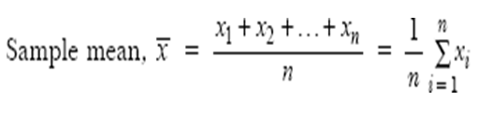
ARITHMETIC MEAN DIRECT METHOD
INDIVIDUAL SERIES -- implies it is Ungrouped (or Raw) Data
In this method A.M. is calculated by adding the values of all observations and dividing the total by the number of observations.
Thus if x₁, x₂,…, x_{N} represent the values of N observations, then A.M. for a population of N observations is:
Mean: The sum of all the data values divided by their number.
However, for a sample n observations x₁, x₂,…, x_{n}, the sample A.M. can be written as:

Slide 48
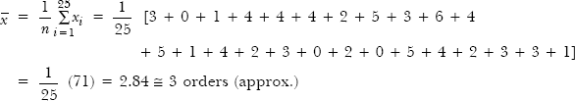
Example INDIVIDUAL SERIES: The number of new orders received by a company over the last 25 working days were recorded as follows: 3, 0, 1, 4, 4, 4, 2, 5, 3, 6, 4, 5, 1, 4, 2, 3, 0, 2, 0, 5, 4, 2, 3, 3, 1. Calculate the arithmetic mean for the number of orders received over all similar working days.

Slide 49
ARITHMETIC MEAN SHORT-CUT METHOD INDIVIDUAL SERIES UN-GROUPED DATA
In this method an arbitrary assumed mean is used as a basis for calculating deviations from individual values in the data set.
Let A be the arbitrary assumed A.M. and let d_{i} = x_{i} – A (Where di is deviation from AM)

Slide 50
EX: Short cut method
ROLL. NO. | MARKS xi | di = xi – A di = xi - 60
1 | 40 | -20
2 | 50 | -10
3 | 55 | -05
4 | 78 | +18
5 | 58 | -02
6 | A → 60 | 00
7 | 73 | +13
8 | 35 | -25
9 | 43 | -17
10 | 48 | -12
 |  | ∑d = - 60
= 60 + (-60 / 10)
= 60 - 6
= 54

Slide 51
ARITHMETIC MEAN DESCRITE SERIES DIRECT METHOD
implies it is Ungrouped (or Raw) Data
EX: The daily earnings (in rupees) of employees working on a daily basis in a firm are:
= ∑ F(X) / ∑F = 34040 / 175 = 194.51
DAILY EARNINGS (IN RUPEES) X | NUMBER OF EMPLOYEES F | F(X)
100 | 3 | 300
120 | 6 | 720
140 | 10 | 1400
160 | 15 | 2400
180 | 24 | 4320
200 | 42 | 8400
220 | 75 | 16500
 | TOTAL = 175 | TOTAL = 34040

Slide 52
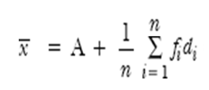
ARITHMETIC MEAN INDIRECT / SHORT CUT METHOD
DESCRITE SERIES UN-GROUPED DATA
The daily earnings (in rupees) of employees working on a daily basis in a firm are:
Calculate the average daily earning for all employees.
d_{i} = x_{i} – A

Slide 53
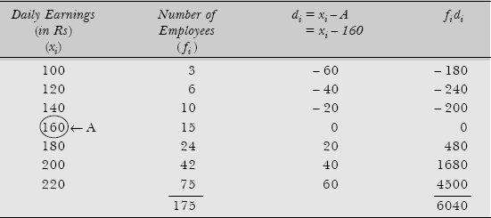

Solution: The calculations of average daily earning for employees are: Calculations of x for Ungrouped Data
Here A = 160 is taken as assumed mean. The required A.M. using the is given by

Slide 54
ARITHMETIC MEAN OF GROUPED (OR CLASSIFIED) DATA
Arithmetic mean for grouped data can also be calculated by applying any of the following methods: Direct method, and
Indirect or Step-deviation method
For calculating arithmetic mean for a grouped data set, the following assumptions are made:
The class intervals must be closed
The width of each class interval should be equal
The values of the observations in each class interval must be uniformly distributed between its lower and upper limits.
The mid-value of each class interval must represent the average of all values in that class, that is, it is assumed that all values of observations are evenly distributed between the lower and upper class limits.

Slide 55

Direct Method GROUPED DATA
Mean value: A measure of central location (tendency) for a data set such that the observations in the data set tend to cluster around it.

Slide 56
EX: A company is planning to improve plant safety. For this, accident data for the last 50 weeks was compiled. These data are grouped into the frequency distribution as shown below. Calculate the A.M. of the number of accidents per week.

Slide 57
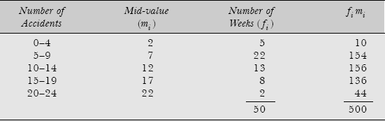

Arithmetic Mean of Accidents
The A.M. of the number of accidents per week is:

Slide 58
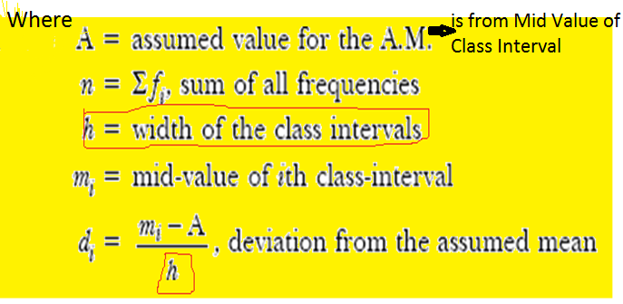
STEP-DEVIATION METHOD (SHORT-CUT) FORMULA

Slide 59

EX. The following distribution gives the pattern of overtime work done by 100 employees of a company. Calculate the average overtime work done per employee.

Slide 60
Solution:
The calculations of the average overtime work done per employee with assumed mean, A = 22.5 and h = 5

Slide 61
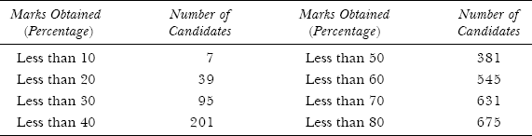
Case 1: Frequencies are Given in Cumulative Form, that is, either ‘More Than Type’ or ‘Less Than Type’
EX: In an examination of 675 candidates, the examiner supplied the following information:
Calculate the mean percentage of marks obtained.

Slide 62
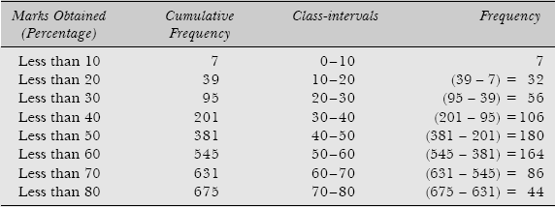
Solution: Arranging the given data into EXCLUSIVE class interval

Slide 63
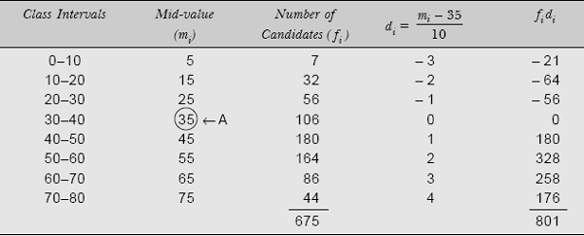
The calculations for mean percentage of marks obtained by the candidates
The mean percentage of marks obtained is:

Slide 64

Case 2: Frequencies are not Given but have to be Calculated From the Given Data
Example: 168 handloom factories have the following distribution of average number of workers in various income groups:
Find the mean salary paid to the workers.

Slide 65
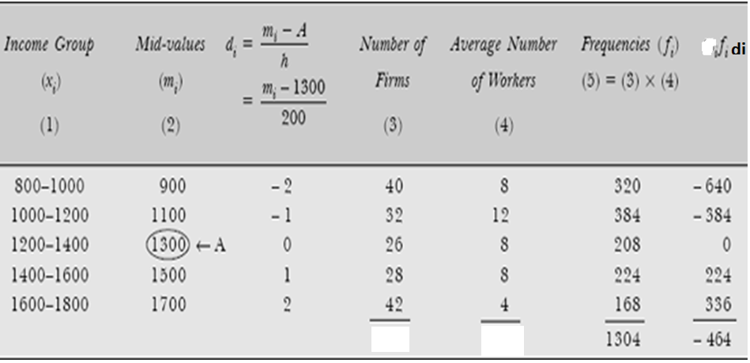


Solution: Since the total number of workers (i.e. frequencies) working in different income groups are not given, therefore these have to be determined

Slide 66
Case 3: Complete Data are Not Given
Example: The pass result of 50 students who took a class test is given below:
If the mean marks for all the students was 51.6 find out the mean marks of the students who failed.

Slide 67
Marks | Frequency (f_{i}) | f_{i} x_{i}
40 | 8 | 320
50 | 10 | 500
60 | 9 | 540
70 | 6 | 420
80 | 4 | 320
90 | 3 | 270
 | 40 | 2370
Total marks of all the students = 50 × 51.6 = 2580
Total marks of 40 students who passed = Σ f_{i}x_{i} = 2370
Thus marks of the remaining 10 students = 2580 – 2370 = 210
Hence, the average marks of 10 students who failed are 210/10 = 21 marks

Slide 68


EX: The mean salary paid to 1500 employees of an organization was found to be Rs 12,500. Later on, after disbursement of salary, it was discovered that the salary of two employees was wrongly entered as Rs 15,760 and 9590. Their correct salaries were Rs 17,760 and 8590. Calculate correct mean.
Solution
This gives the total salary disbursed to all 1500 employees. Now after adding the correct salary figures of two employees and subtracting the wrong salary figures posted against two employees, we have

Slide 69
Thus the correct mean salary is given by
1,88,01,700 ÷ 1500 = Rs 12,534.46

Slide 70
COMBINED MEAN AND VARIANCE

Slide 71


EX: There are two units of an automobile company in two different cities employing 760 and 800 persons, respectively. The arithmetic means of monthly salaries paid to persons in these two units are Rs 18,750 and Rs 16,950 respectively. Find the combined arithmetic mean of salaries of the employees in both the units.
Solution: Let n₁ and n₂ be the number of persons working in unit 1 and 2 respectively, and and be the arithmetic mean of salaries paid to these persons respectively.
Thus the combined mean of salaries paid by the company is

Slide 72
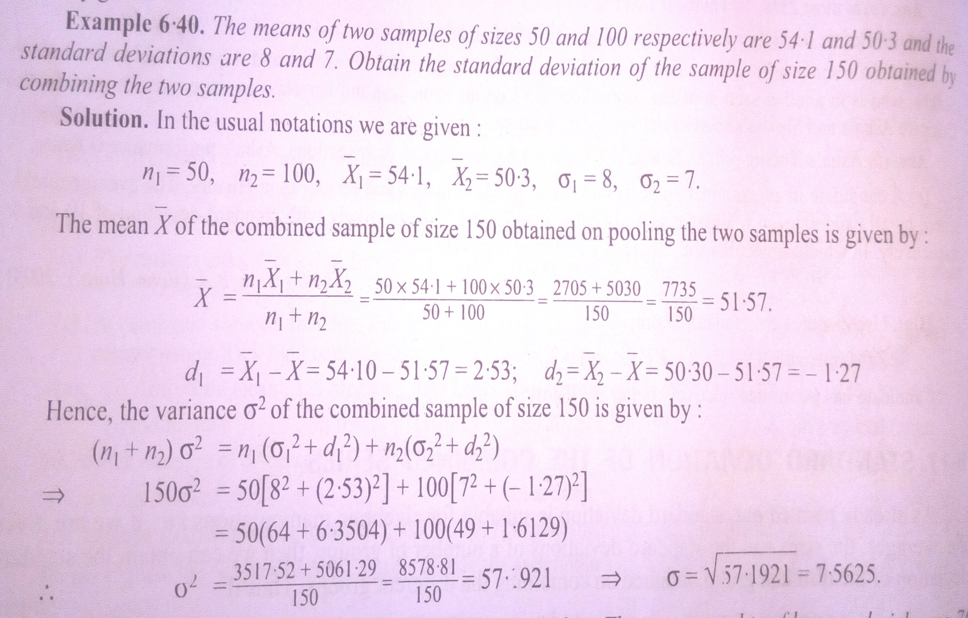
COMBINED MEAN AND VARIANCE

Slide 73
Advantages
1. The calculation of arithmetic mean is simple and it is unique, that is, every data set has one and only one mean.
2. The calculation of arithmetic mean is based on all values given in the data set.
3. The arithmetic mean is reliable single value that reflects all values in the data set.
4. The arithmetic mean is least affected by fluctuations in the sample size.

Slide 74
Disadvantages
The value of A.M. cannot be calculated accurately for unequal and open-ended class intervals either at the beginning or end of the given frequency distribution.
The A.M. is reliable and reflects all the values in the data set.
However, it is very much affected by the extreme observations (or outliers) which are not representative of the rest of the data set. Outliers at the high end will increase the mean, while outliers at the lower end will decrease it. For example, if monthly income of four persons is 50, 70, 80, and 1000, then their A.M. will be 300, which does not represent the data.
An outlier is an observation that lies an abnormal distance

Slide 75
The calculations of A.M. sometime become difficult because every data element is used in the calculation (unless the short cut method for grouped data is used to calculate the mean). Moreover the value so obtained may not be among the observations included in the data.
The mean cannot be calculated for qualitative characteristics such as intelligence, honesty, beauty, or loyalty.
5. The mean cannot be calculated for a data set that has open-ended classes at either the high or low end of the scale.

Slide 76
PROPERTIES OF ARITHMETIC MEAN
1. The algebraic sum of deviations of all the observations xi (i = 1, 2…, n) from the A.M. is always zero, Due to this property, the mean is characterized as a point of balance, i.e. sum of the positive deviations from mean is equal to the sum of the negative deviations from mean.
  2. The sum of the squares of the deviations of all the observations from the A.M. is less than the sum of the squares of all the observations from any other quantity. This property of A.M. is also known as the least square property and shall be quite helpful in defining the concept of standard deviation
  3. It is possible to calculate the combined (or pooled) arithmetic mean of two or more than two sets of data of the same nature.
Let and be arithmetic means of two sets of data of the same nature of size n₁ and n₂respectively. Then their combined A.M. can be calculated as:

Slide 77
MEDIAN
Median may be defined as the middle value in the data set when its elements are arranged in a sequential order, that is, in either ascending or descending order of magnitude.
From the middle value what we observe is half of the observations are smaller and half are larger than this value.
The median is thus a measure of the location or centrality of the observations.
The median can be calculated for both ungrouped and grouped data sets.

Slide 78
MEDIAN INDIVIDUAL SERIES (ungrouped)
If the number of observations (n) is an odd number
EX. Calculate the median of the following data that relates to the service time (in minutes) per customer for 7 customers at a railway reservation counter: 3.5, 4.5, 3, 3.8, 5.0, 5.5, 4
Solution: The data are arranged in ascending order as follows: The median for this data would be
Med = value of (n + 1)/2 observation in the data array
{(7 + 1) ÷ 2} = 4th observation ➔ corresponding item i.e., in the data array = 4 minutes (service)
Thus the median service time is 4 minutes per customer.

Slide 79
MEDIAN INDIVIDUAL SERIES (ungrouped)
If the number of observations (n) is an Even number
Calculate the median of the following data that relates to the number of patients examined per hour in the outpatient ward (OPD) in a hospital: 10, 12, 15, 20, 13, 24, 17, 18
Solution: The data are arranged in ascending order as follows:
Med = value of (n + 1)/2 observation in the data array ,
i.e., {(8 + 1) ÷ 2} = 4.5th observation in the data array which lies between 4th and 5th obsn.
➔ corresponding item will be = (4th Obsn + 5th Obsn) ÷ 2
that is (15 + 17) / 2 = 16
Thus median number of patients examined per hour in OPD in a hospital are 16.

Slide 80
MEDIAN DESCRITE SERIES implies it is Ungrouped (or Raw) Data
FORMULA: {(N + 1) ÷ 2} ^{th} = {(175 + 1) ÷ 2} = 88 → check where cumulative frequency JUST GREATER than 88 → which is 100. MARK THIS.
Now go in this row check ‘X’ = 200. therefore 200 is median
DAILY EARNINGS (IN RUPEES) X | NUMBER OF EMPLOYEES F | CUMULATIVE FREQUENCY (Cf)
100 | 3 | 3
120 | 6 | 9
140 | 10 | 19
160 | 15 | 34
180 | 24 | 58
200 | 42 | 100
220 | 75 | 175
 | ∑F = 175

Slide 81

TO FIND THE MEDIAN VALUE FOR GROUPED DATA

Slide 82
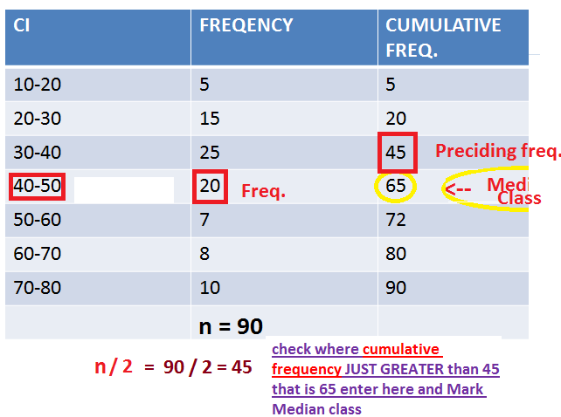

Slide 83
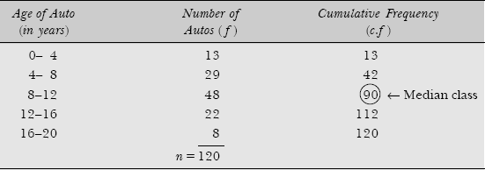
EX. A survey was conducted to determine the age (in years) of 120 automobiles. What is the median age for the autos?
Soln:
Here the total number of observations (frequencies) are n = 120. Median is the size of (n/2)th = 120 ÷ 2 = 60th check where cumulative frequency JUST GREATER than 60 → which is 90. MARK THIS MEDIAN CLASS.

Slide 84
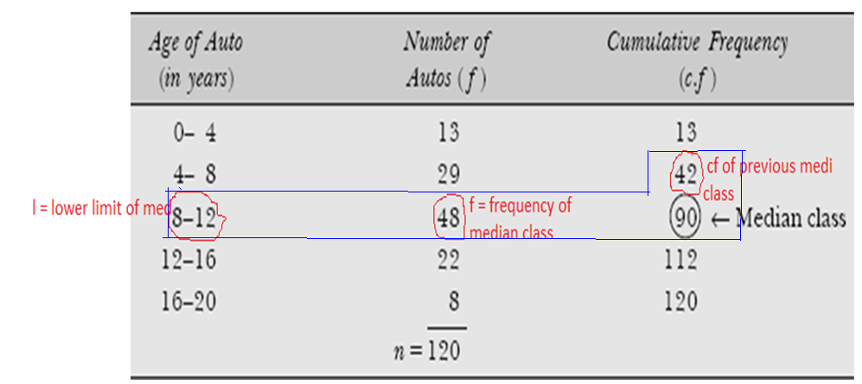



Slide 85
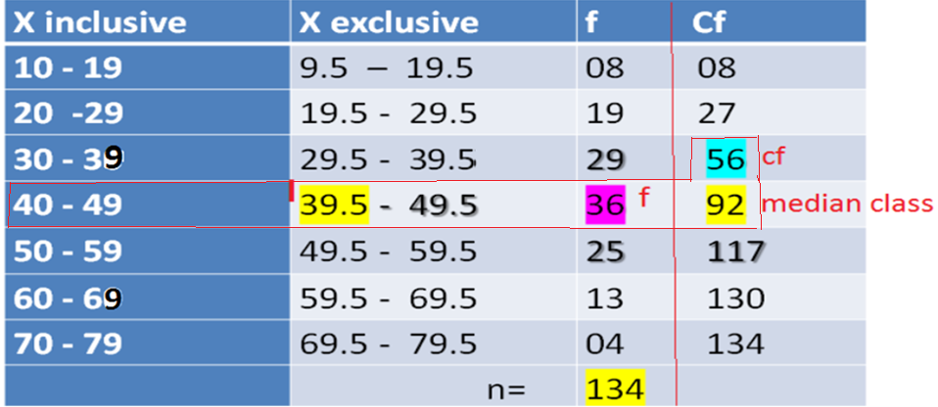
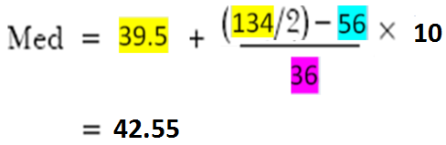
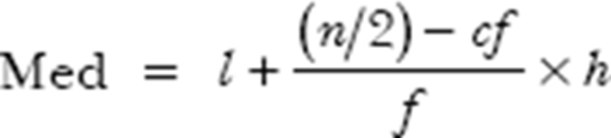
Median in case of Inclusive

Slide 86
Advantages
1. Median is unique, i.e. like mean, there is only one median for a set of data.
2. The value of median is easy to understand and may be calculated from any type of data. The median in many situations can be located simply by inspection.
3. The sum of the absolute differences of all observations in the data set from median value is minimum. In other words, the absolute difference of observations from the median is less than from any other value in the distribution. That is, Σ |x – Med| = a minimum value.
4. The extreme values in the data set does not affect the calculation of the median value and therefore it is the useful measure of central tendency when such values do occur.
5. The median is considered the best statistical technique for studying the qualitative attribute of a an observation in the data set.
6. The median value may be calculated for an open-end distribution of data set.

Slide 87
Disadvantages
The median is not capable of algebraic treatment. For example, the median of two or more sets of data cannot be determined.
The value of median is affected more by sampling variations, that is, it is affected by the number of observations rather than the values of the observations. Any observation selected at random is just as likely to exceed the median as it is to be exceeded by it
Since median is an average of position, therefore arranging the data in ascending or descending order of magnitude is time consuming in case of a large number of observations.
The calculation of median in case of grouped data is based on the assumption that values of observations are evenly spaced over the entire class-interval.
Applications
The median is helpful in understanding the characteristic of a data set when
1. observations are qualitative in nature
2. extreme values are present in the data set
3. a quick estimate of an average is desired.

Slide 88
MODE
The mode is that value of an observation which occurs most frequently in the data set, that is, the point (or class mark) with the highest frequency. This method can be applied with ease and simplicity if the distribution is UNIMODAL - having only one mode.
However, the mode is not necessarily unique, unlike arithmetic mean and median. You can have data with two modes (bi-modal) or more than two modes (multi-modal). It may be possible that there may be no mode if no value appears more frequent than any other value in the distribution
The concept of mode is of great use to large scale manufacturers of consumable items such as ready-made garments, shoe-makers, and so on. In all such cases it is important to know the size that fits most persons rather than ‘mean’ size.

Slide 89
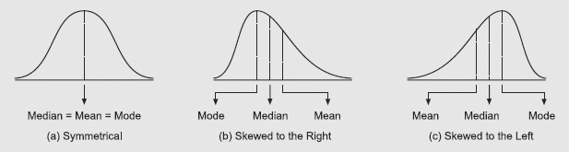

A distribution that is not symmetrical, but rather has most of its values either to the right or to the left of the mode, is said to be skewed. For such asymmetrical distribution, Karl Pearson has suggested a relationship between these three measures of central tendency as:

Slide 90

In the case of grouped data, the following formula is used for calculating mode:
where l = lower limit of the model class interval
fm = modal frequency ( MAXIMUM FREQUENCY OCCURANCE)
fm – 1 = frequency of the class preceding the mode class interval
fm + 1 = frequency of the class following the mode class interval
h = width of the mode class interval

Slide 91
FOR COMPUTING MODE WE HAVE FOLLOWING ASSUMPTIONS :
The frequency distribution must be continuous with exclusive type classes without any gaps. If the data are not given in the form of continuous classes, it must first be converted into continuous classes before applying formula
(ii) The class intervals must be uniform throughout i.e., the width of all the class intervals must be the same.
In case of the distribution with unequal class intervals, they should be made equal under the assumption that the frequencies are uniformly distributed over all the classes, otherwise the value of mode computed from will give misleading results.
However, the above technique of locating mode is not practicable in the following situations :
(i) If the maximum frequency is repeated or approximately equal concentration is found in two or more neighbouring values.
(ii) If the maximum frequency occurs either in the very beginning or at the end of the distribution.
(iii) If there are irregularities in the distribution i.e., the frequencies of the variable increase or decrease in a haphazard way.

Slide 92
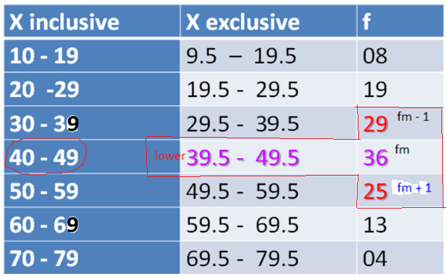
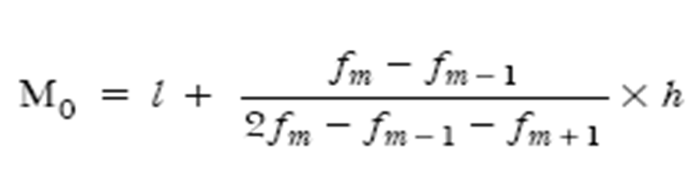
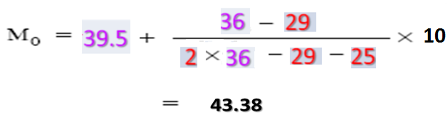
EX:

Slide 93
Advantages
1. Mode value is easy to understand and to calculate. Mode class can also be located by inspection.
2. The mode is not affected by the extreme values in the distribution. The mode value can also be calculated for open-end frequency distributions.
3. The mode can be used to describe quantitative as well as qualitative data. For example, its value is used for comparing consumer preferences for various types of products, say cigarettes, soaps, toothpastes, or other products.
Disadvantages
1. Mode is not a rigidly defined measure as there are several methods for calculating its value.
2. It is difficult to locate modal class in the case of multi-modal frequency distributions.
3. Mode is not suitable for algebraic manipulations.
4. When data sets contain more than one modes, such values are difficult to interpret and compare.

Slide 94
NOTE: When Inclusive CI is given → Convert to exclusive when we are solving for MEDIAN and MODE → because
the formula has lower limits of class interval of median class for median
the formula has lower limits of class interval of frequency modal for calculating MODE

Slide 95
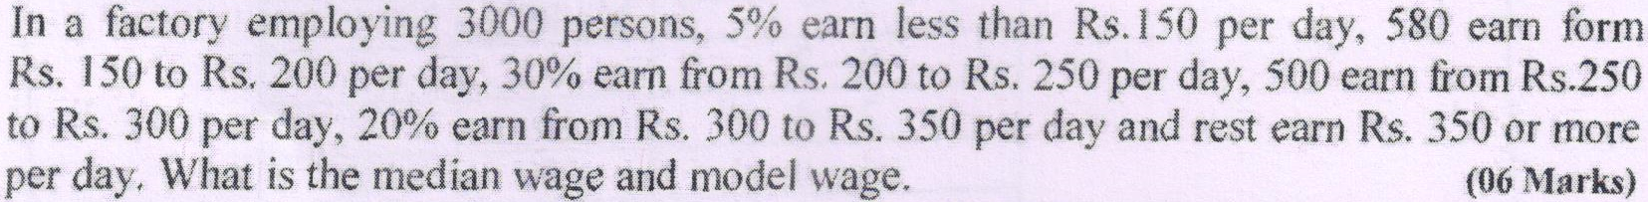
CLASS INTERVAL | FREQUENCY | Cum Fre
< 150 | 5% of 3000 = 150 | 150
150 - 200 | 580 | 730
200 - 250 | 30% of 3000 = 900 | 1630
250 - 300 | 500 | 2130
300 - 350 | 20% of 3000 = 600 | 2730
>350 | 270 | 3000

Slide 96
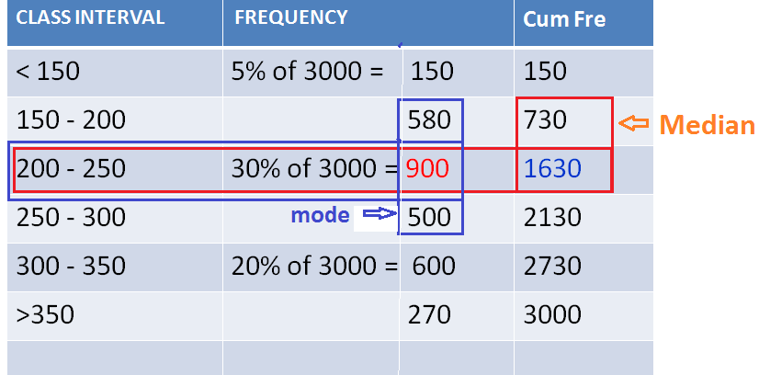

Slide 99
Marks | Frequency | Cumulative Frequency
0 - 10 | 8 | 8
10 – 20 | 15 | 23
20 - 30 | 30 | 45
30 - 40 | 35 | 65
40 - 50 | 40 | 75
50 - 60 | 40 | 80

Slide 100

RELATIVE POSITION OF ARITHMETIC MEAN, MEDIAN AND MODE
Suppose we express,
Arithmetic Mean = Me
Median = Mi
Mode = Mo The relative magnitude of the three are
The median is always between the arithmetic mean and the mode.

Slide 101
RELATIVE POSITION OF ARITHMETIC MEAN, MEDIAN AND MODE
Suppose we express,
Arithmetic Mean = Me
Median = Mi
Mode = Mo The relative magnitude of the three are
The median is always between the arithmetic mean and the mode.

